Slide 1
Azure Management Tools

Slide 2
Executive summary
Purpose
Layout
Style
The executive summary should be a brief, stand-alone version of a document that focuses on the most important messages, meant to be read rather than presented.
Do not include any content that is not in the body of the document.
Use the columns in this layout to organize the content.
If you need more than 3 columns, use two rows or add a second page.
Be brief. Write the shortest, simplest sentences possible.
Favor active over passive verbs.
Use plain words and the client’s terminology, not consulting jargon.
Source: …

Slide 3
Agenda
The Azure Portal
Azure and PowerShell
Azure CLI
Azure Advisor

Slide 4
The Azure portal
Everything that you do in the Azure portal calls ARM on the back-end.
The default view in the portal is Home. From here, you can see icons for various Azure services, and if you click on one of those icons, it will show you any resources of that type that you’ve created. The menu on the left side includes these same icons, and more.
The bottom portion of the screen includes large tiles designed to help you learn more about Azure. If you click on one of the links provided in these tiles, a new tab will open in your browser so you don’t lose your place in the portal.
Along the top colored bar, you’ll find a search bar where you can search for Azure services, docs, or your Azure resources. To the right of the search box is a button that will launch Azure Cloud Shell. Cloud Shell is a web-based command shell where you can interact with Azure from the command-line. You can create Azure resources and more. As you’re reading through Azure documentation, you may see a Try It button, and those buttons use Cloud Shell to help you test out different services and features

Slide 5
The Azure portal
To the right of the Cloud Shell button is a filter button that allows you to configure the portal to only show resources in a certain Azure subscription or Azure Active Directory. To the right of that is the Notification button.
To the right of the notifications button is the Settings button. Clicking on that brings up a panel where you can alter portal settings.
From Settings, you can change your default view, you can alter the color scheme of the portal, you can disable toast notifications, or pop up notifications that Microsoft may display from time to time. Other settings that appear here may change as Microsoft adds new features.

Slide 6
The Azure portal
If you click on your name in the upper-right corner, you can log out or switch to other Azure accounts. You can also change the Azure Active Directory to access resources in another directory. This is helpful if your company has a corporate directory and you also have a personal directory.
The menu along the left side of the portal contains a default list of Azure resources. Clicking on one of those will display all resources of that type.

Slide 7
Agenda
The Azure Portal
Azure and PowerShell
Azure CLI
Azure Advisor

Slide 8
Azure and PowerShell
If you’re a PowerShell user, you can take advantage of that knowledge to manage your Azure resources using the Azure PowerShell Az module. This module offers cross-platform support, so whether you’re using Windows, Linux, or macOS, you can use the PowerShell Az module.
Before you can use the PowerShell Az module, you’ll need to install it. To do that, you first need to run PowerShell elevated. In Windows, that means running it as an Administrator. In Linux and macOS, you’ll need to run it with superuser privileges using sudo.
To install the module, run the following command.
Install-Module -Name Az -AllowClobber
If you are unable to run PowerShell elevated, you can install the module for your user ID only by using the following command.
Install-Module -Name Az -AllowClobber -Scope CurrentUser

Slide 9
Azure and PowerShell
Once you’ve installed the module, you need to sign in with your Azure account. To do that, run the following command.
Connect-AzAccount
This command will display a token in the PowerShell window. You’ll need to browse to https://microsoft.com/devicelogin and enter the code in order to authenticate your PowerShell session. If you close PowerShell, you’ll have to run the command again in your next session.
If you have more than one Azure subscription, you’ll want to set the active subscription so that commands you enter will impact the desired subscription. You can do that using the following command.
Set-AzContext -Subscription "subscription"
Replace subscription with the name or subscription ID of your Azure subscription you want to use with the Az module.

Slide 10
Azure and PowerShell
All Az module commands will have a common syntax that starts with a verb and an object. Verbs are things like New, Get, Move, or Remove. The object is the thing that you want the verb to impact.
In many situations, you will be including PowerShell commands in a script so that you can perform a number of operations at once. In that case, you won’t be able to confirm a command by typing y, so you can use the -Force parameter to bypass the prompt.

Slide 11
Agenda
The Azure Portal
Azure and PowerShell
Azure CLI
Azure Advisor

Slide 12
Azure CLI
If you want to script with PowerShell, however, you’ll need someone who knows PowerShell development. If you don’t have anyone who can do that, the Azure command-line interface (Azure CLI) is a great choice. Azure CLI can be scripted using shell scripts in various languages like Python, Ruby, and so on.
Like the PowerShell Az module, the Azure CLI is cross-platform and works on Windows, Linux, and macOS as long as you use the 2.0 version. Installation steps are different depending on your platform.
Once you install the Azure CLI, you’ll need to login to your Azure account. To do that, run the following command:
az login
When you run this command, the CLI will open a browser automatically for you to login. Once you login, if you have multiple Azure subscriptions, you can set the default one by entering the following command.
az account set --subscription "subscription"
Replace subscription with the name or subscription ID you want to use.

Slide 13
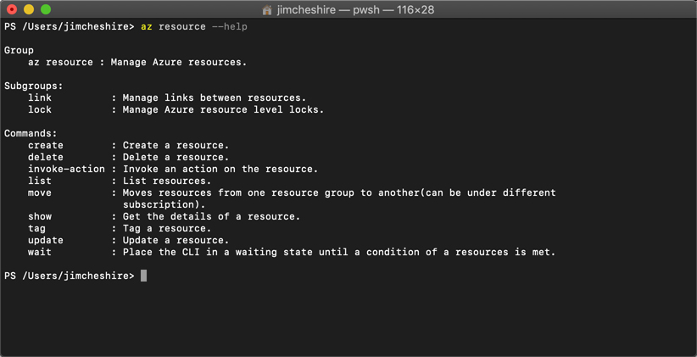
Azure CLI
To find a list of commands you can run with the CLI, type az and press Enter. You’ll see a list of all the commands you can run. You can find detailed help on any command by entering the command and adding a --help parameter.
You can take this a step further if you aren’t sure what the commands do. You can, for example, run the following command to get help on the syntax for az resource create.
az resource create --help

Slide 14
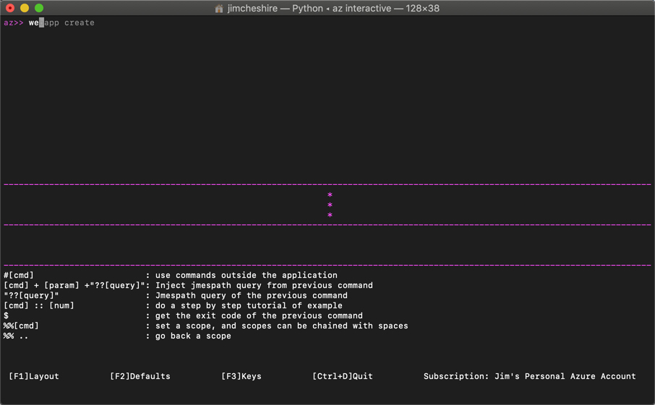
Azure CLI
An even easier way to learn the CLI is to switch into interactive mode. This provides you with auto-complete, the scoping of commands, and more. To switch into interactive mode enter az interactive at the command prompt. The CLI will install an extension to add this functionality.

Slide 15
Azure CLI
You can find a list of all available extensions that Microsoft provides by running the following command:
az extension list-available --output table
This will not only show you available extensions, but it will show you if you already have the extension installed and if there’s an update you should install. To install an extension, run the following command.
az extension add --name extension_name
Replace extension_name with the name of the extension you want to install.

Slide 16
Agenda
The Azure Portal
Azure and PowerShell
Azure CLI
Azure Advisor

Slide 17
Azure Advisor
Azure can notify you about problems in your configuration so that you can avoid problems. It does this via the Azure Advisor.
Azure Advisor can offer advice in the area of high availability, security, performance, and cost. While the documentation states that Azure Advisor is available only for Azure VMs, availability sets, application gateways, App Service applications, SQL Server, and Azure Redis Cache, many more services are onboarded to Azure Advisor and you will get recommendations for just about all of your Azure services.

Slide 18
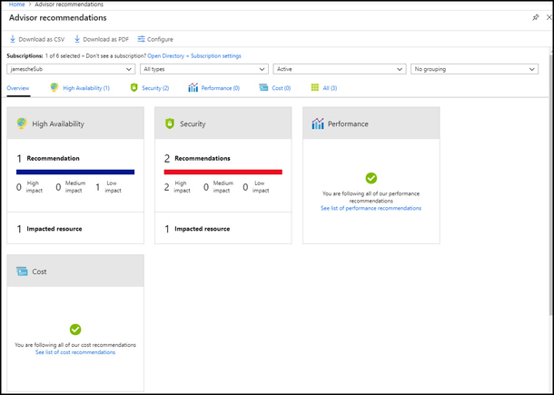
Azure Advisor
To access Azure Advisor, log into the Azure portal and click Advisor in the menu on the left.

Slide 19
Azure Advisor
To review details on a recommendation, click the tile.
You don’t have to do what Azure Advisor recommends. If you click on the description, you can decide to postpone or dismiss the alert. If you choose to postpone the alert, you have the option of being reminded in 1 day, 1 week, 1 month, or 3 months.
If you have a large number of recommendations, or if you’re not the right person to take action on the recommendations, you can download Azure Advisor recommendations as either a comma-separated values file or a PDF. Click Download As CSV or Download As PDF. You can also download a file with specific recommendations by clicking the appropriate download button while reviewing details

